Slide 1
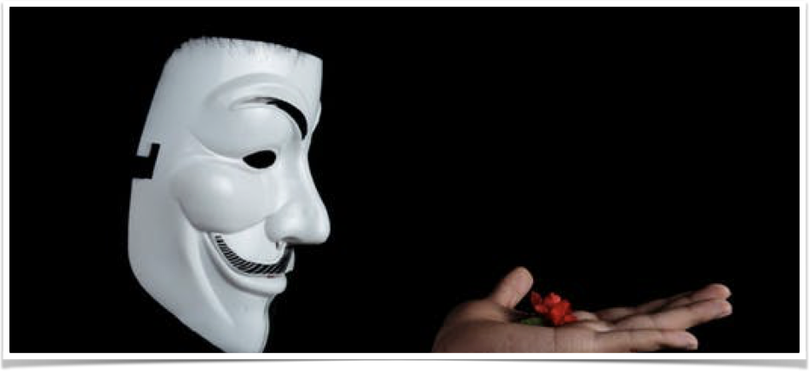
Application Security
101
AppSec - Secure Coding Practices
Ryan Bowling
@jryanbowling

Slide 2
Short Bio
CS Major
Started out as developer at a start-up
AppDev at Duke in 2005
Lead Dev/Tech lead at Bank of America in 2007
Solution Architect at Duke in 2009
Enterprise Architect at AmerisourceBergen in early 2014
Solution Architect at Duke in late 2014
Security Architect at Duke in early 2016 – earned CISSP in 2017
https://youtu.be/wMEq1mGpP5A?t=80

Slide 3
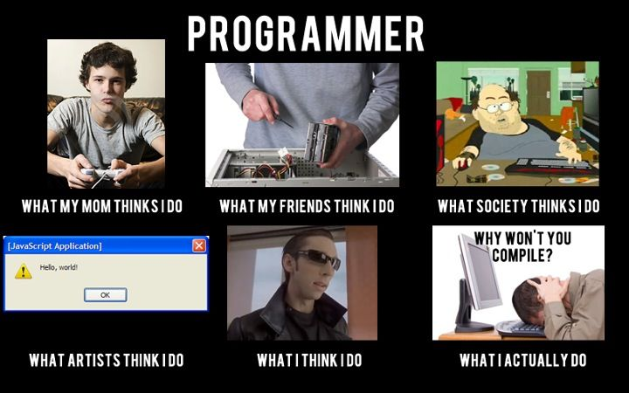

Slide 4
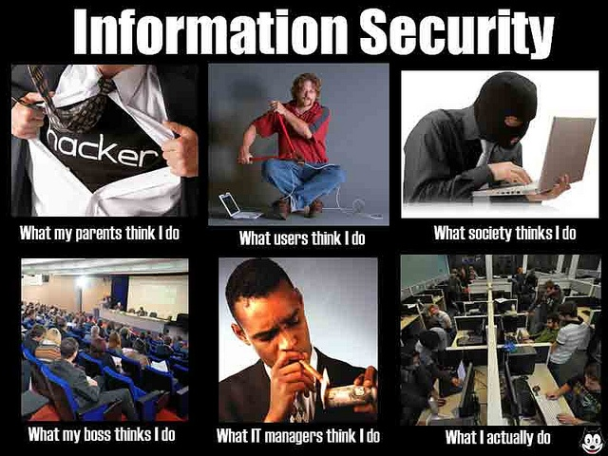

Slide 5
Why is security important?
To the Energy/Utilities sector:
Aurora Generator Test
To prepare for the experiment, the researchers procured and installed a 2.25 MW generator and connected it to the substation. They also needed access to a programmable digital relay or another device that controls the breaker. That access could have been through a mechanical or digital interface.^{[3]}
In the experiment, the researchers used a cyber attack to open and close the breakers out of sync, to maximize the stress. Each time the breakers were closed, the torque from the synchronization caused the generator to bounce and shake, eventually causing parts of the generator be to ripped apart and sent flying off.^{[4]} Some parts of the generator landed as far as 80 feet away from the generator.^{[5]}
The unit was destroyed in roughly three minutes. However, this was only because the researchers assessed the damage from each iteration of the attack. A real attack could have destroyed the unit much faster
https://en.wikipedia.org/wiki/Aurora_Generator_Test
https://www.youtube.com/watch?v=fJyWngDco3g

Slide 6
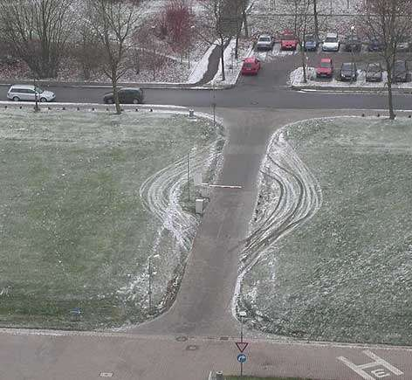
Reality

Slide 7
Terms
Threat Actor
Person or persons that may be responsible for incidents against an organization. Also known as a malicious actor AKA bad actor.
Vulnerability
Weakness in an information system, system security procedures, internal controls, or implementation that could be exploited or triggered by a threat source
Exploit
Use of known vulnerability to cause system to act in an unintended action typically for maliciously purposes.
Risk
The level of impact on organizational operations, organizational assets, or individuals resulting from the operation of an information system given the potential impact of a threat and the likelihood of that threat occurring.
Note: Some of these definitions were directly quoted from NIST and/or TechTarget and/or a combination made up by me.

Slide 8
Why is Application Security Important?
HeartBleed - Improper input validation; over half million of secure Internet’s servers impacted (worst vuln found)—estimated over $500 million in damage as a starting point
https://en.wikipedia.org/wiki/Heartbleed
Ashley Madison - Life’s too short—write secure code.
https://www.scmagazineuk.com/ashley-madisons-source-code-reveals-poor-security-practices/article/535024/
Yahoo — 1 Billion user accounts - MD5 Passwords
https://yahoo.tumblr.com/post/154479236569/important-security-information-for-yahoo-users
John Oliver’s take:
https://youtu.be/61v39UdxzoE

Slide 9
OWASP Top 10 – 2017 (RC)

Slide 10
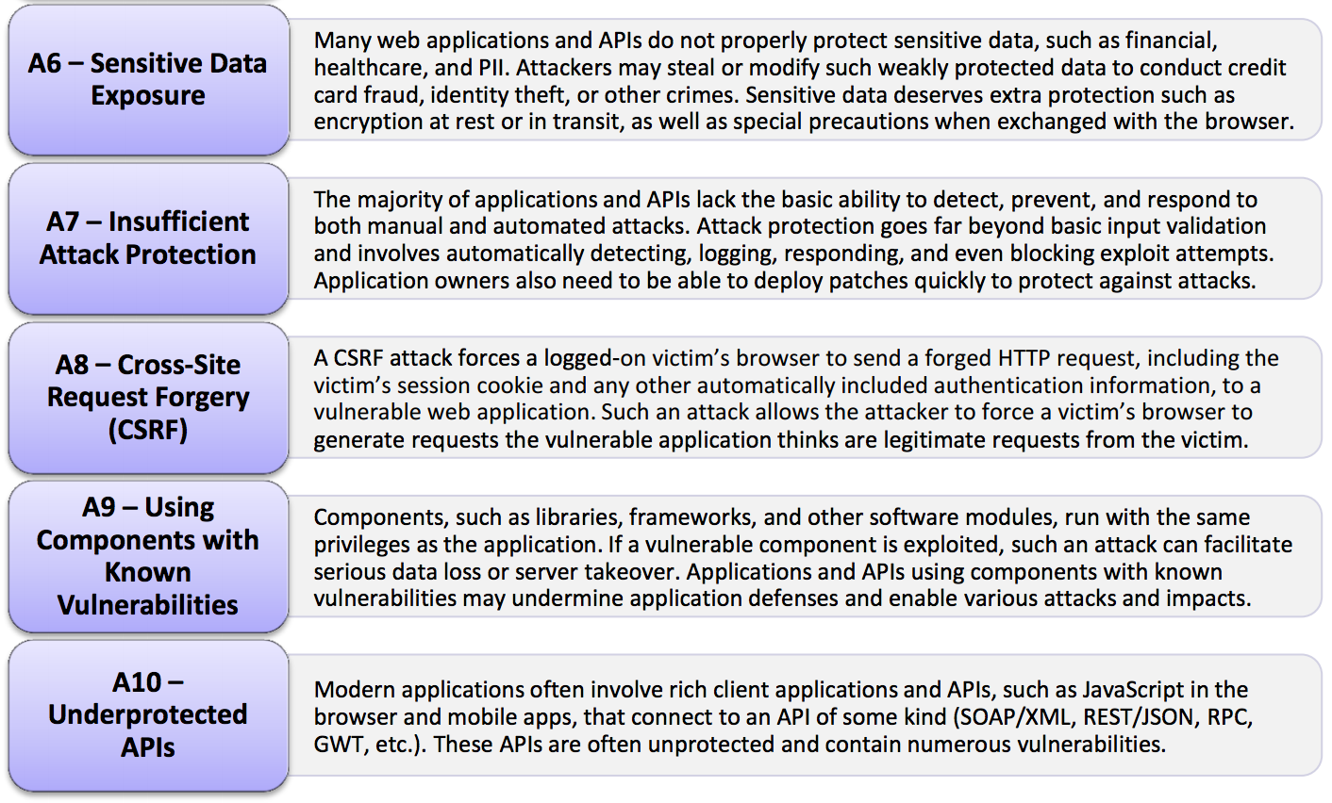
OWASP Top 10 – 2017 (RC)

Slide 11
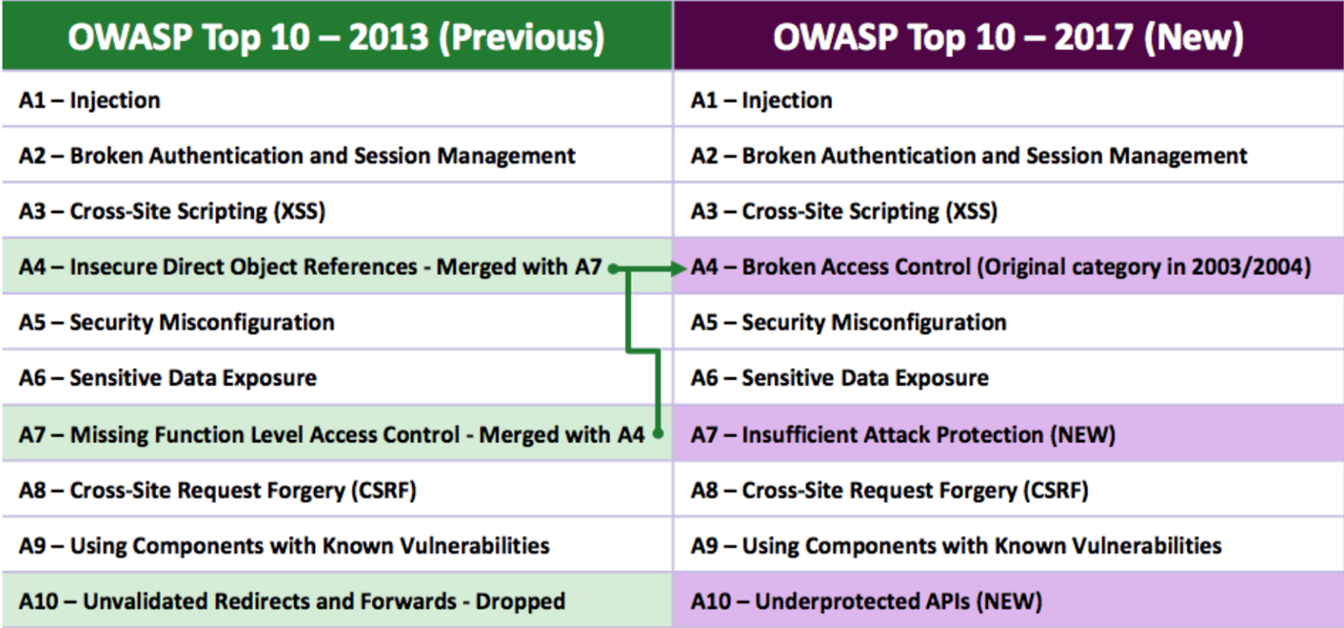
2013 vs 2017

Slide 12
“What am I supposed to do about security?
I write code.”
–Some developer

Slide 13
“Security is everyone’s responsibility.”
–Some security dude

Slide 14
SANS/MITRE Top25
The 2011 CWE/SANS Top 25 Most Dangerous Software Errors is a list of the most widespread and critical errors that can lead to serious vulnerabilities in software. They are often easy to find, and easy to exploit. They are dangerous because they will frequently allow attackers to completely take over the software, steal data, or prevent the software from working at all.
The Top 25 list is a tool for education and awareness to help programmers to prevent the kinds of vulnerabilities that plague the software industry, by identifying and avoiding all-too-common mistakes that occur before software is even shipped. Software customers can use the same list to help them to ask for more secure software. Researchers in software security can use the Top 25 to focus on a narrow but important subset of all known security weaknesses. Finally, software managers and CIOs can use the Top 25 list as a measuring stick of progress in their efforts to secure their software.
The list is the result of collaboration between the SANS Institute, MITRE, and many top software security experts in the US and Europe. It leverages experiences in the development of the SANS Top 20 attack vectors (http://www.sans.org/top20/) and MITRE's Common Weakness Enumeration (CWE) (http://cwe.mitre.org/). MITRE maintains the CWE web site, with the support of the US Department of Homeland Security's National Cyber Security Division, presenting detailed descriptions of the top 25 programming errors along with authoritative guidance for mitigating and avoiding them. The CWE site contains data on more than 800 programming errors, design errors, and architecture errors that can lead to exploitable vulnerabilities.
http://cwe.mitre.org/top25/

Slide 15
Play Time – SQLi
SQL Injection Demo
Navigate to with Incognito Mode: https://www.codebashing.com/sql_demo

Slide 16
Play Time -- XSS
Cross Site Scripting
Navigate to with Incognito Mode: https://cxa.codebashing.com/courses/nodejs/lessons/persistent_stored_xss

Slide 17
Go fish…
Tons of materials out on the web but OWASP does provide security materials focused on developers
Download WebGoat
Go through the lesson plans

Slide 18
Adding Security to Development
Secure SDLC
Push Left
Security Testing
Static Analysis
Fuzzing
Dynamic Analysis
Pen Testing

Slide 19
Key Takeaways
Security is everyone’s responsibility.
Always think like a “bad guy” — be defensive, skeptical, and even a bit paranoid.
It’s not if, it’s when.

